Slide 1

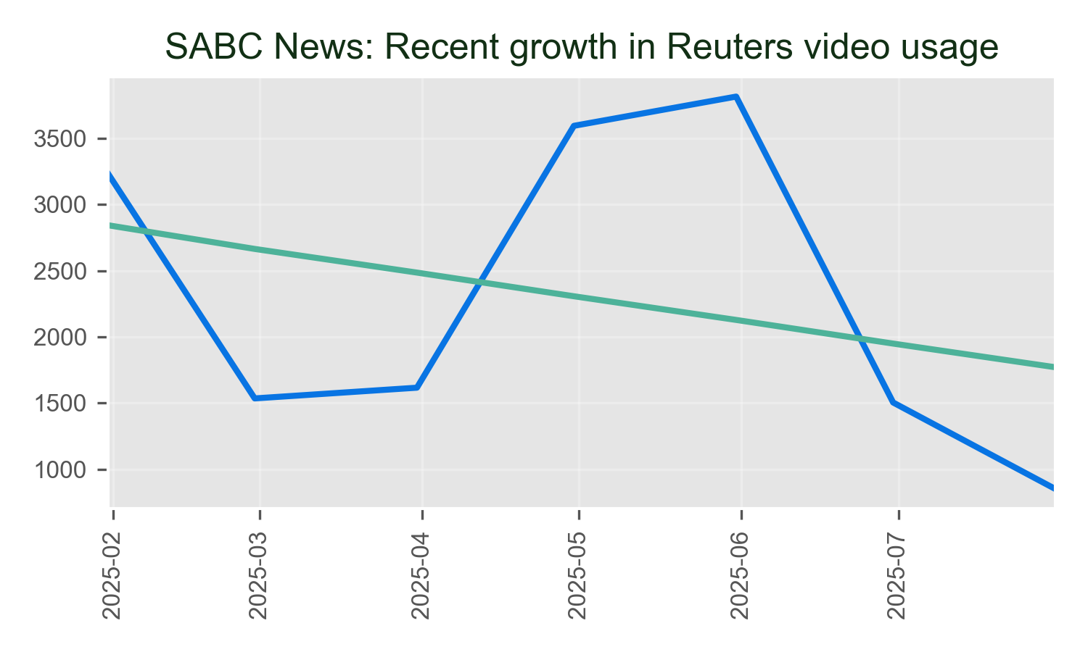
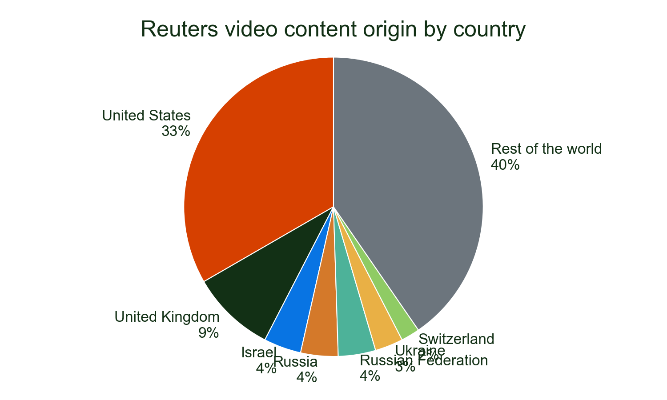
SABC News has shown strong growth in Reuters video usage, with a 11% increase in the most recent month.
Their coverage prominently features Reuters video from South Africa and other key regions, demonstrating the global reach of our partnership.
Major stories
• HEALTH: 16.5%
• USA: 6.5%
• ISRAEL: 6.1%
Of all detections of Reuters video on SABC News in 2025.

